Slide 1
Website Hosting with High Availability & Fault Tolerance

Slide 2
Description of the Project
Website Hosting : We developed a website using HTML, CSS, and JavaScript and looking to host this site to make it accessible to our customer. The goal is to ensure that the website is alive and available to users globally.
High Availability : To guarantee that our website remains accessible at all times, regardless of the traffic demands or user's location , we have designed the infrastructure to ensure continuous availability. This approach ensures that the website is reliably accessible from anywhere and at any time, meeting the needs of our customer .
Fault Tolerance : Fault Tolerance is the capability of a system to continue functioning properly in the event of a failure of some of its components. For a website, this involves creating mechanisms to automatically handle failures and maintain service availability. It ensures that if a part of the system fails, the website remains operational and users do not experience disruptions.

Slide 3
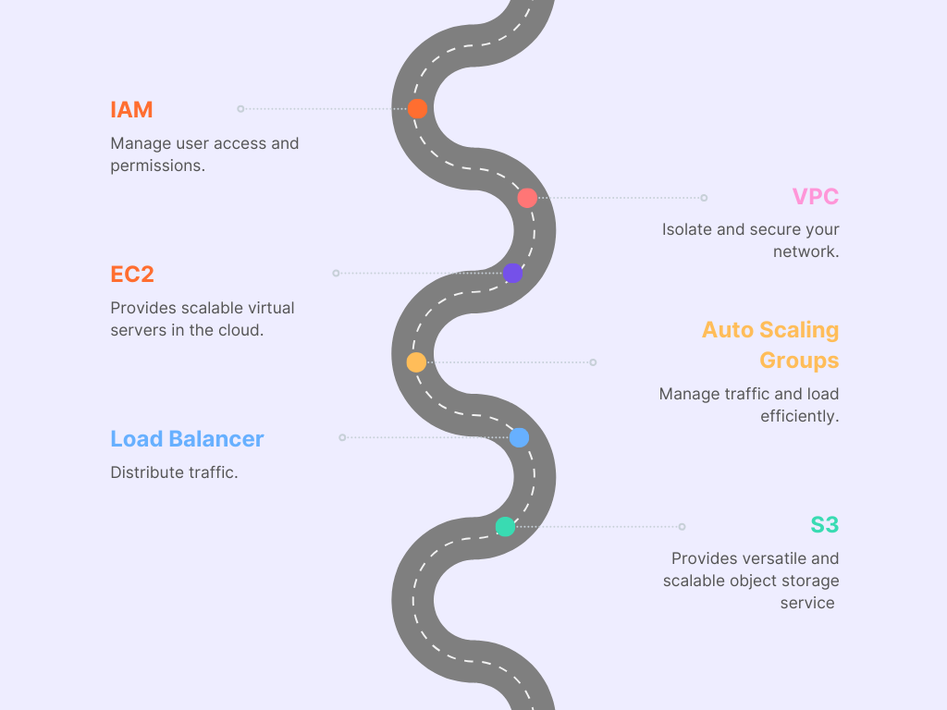
Flowchart of the Project

Slide 4
Services used for Project
1.IAM (Identity & Access Management)
- Users
2.VPC (Virtual Private Cloud)
- VPC & Subnets
- Internet Gateway & NAT Gateway
- Route Tables
3.EC2 (Elastic Compute Cloud)
- Template , Auto Scaling Groups
- Load Balancer, Target Group
- Instance
4.S3 (Simple Storage Service)
- Bucket

Slide 5
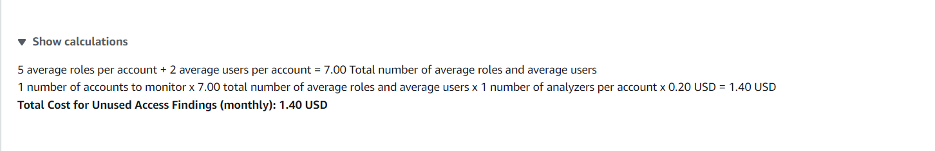
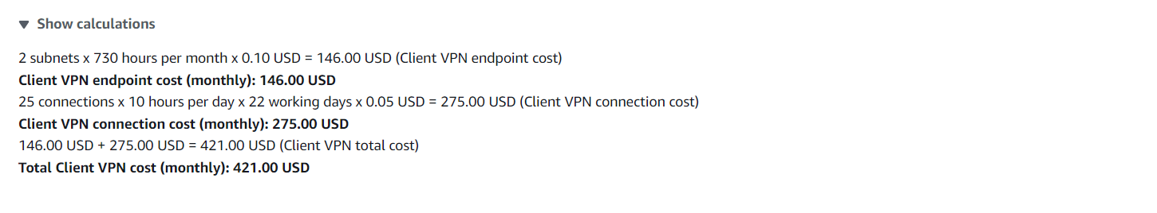
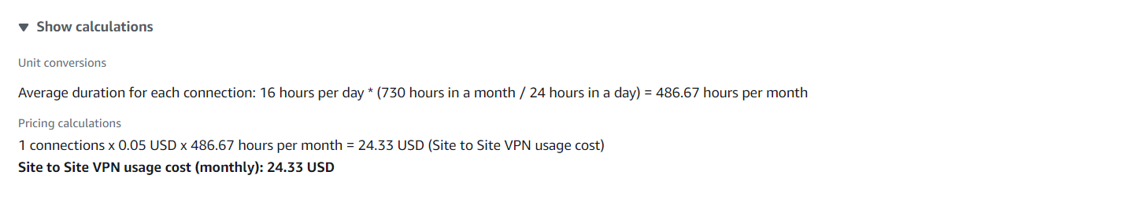
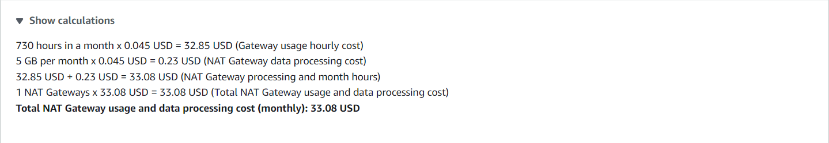
Pricing of the Project
IAM
VPC
VPC (Subnets)
VPC (NAT Gateway)

Slide 6
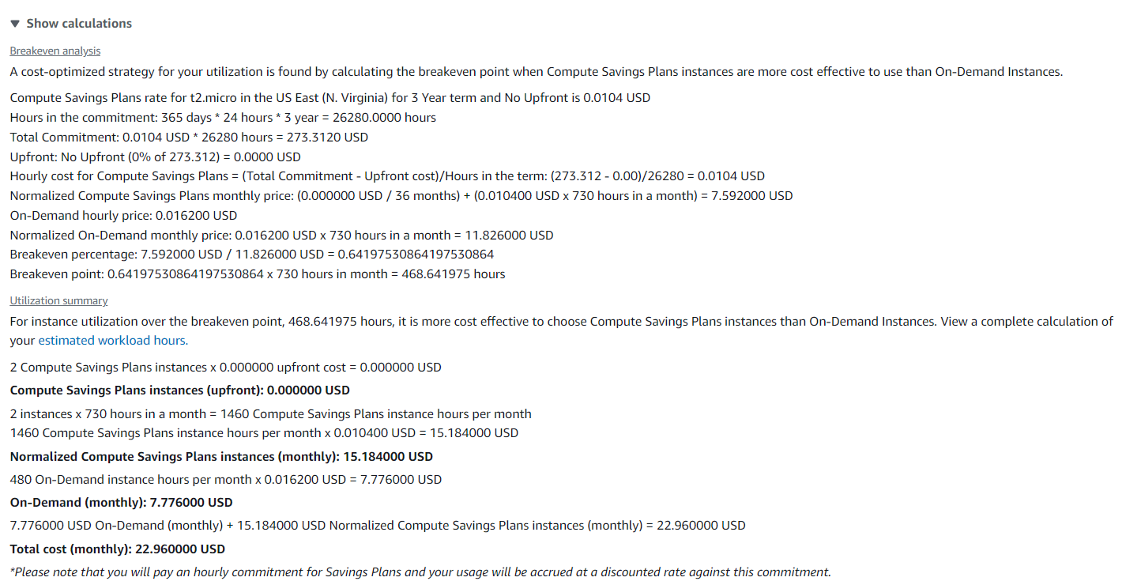
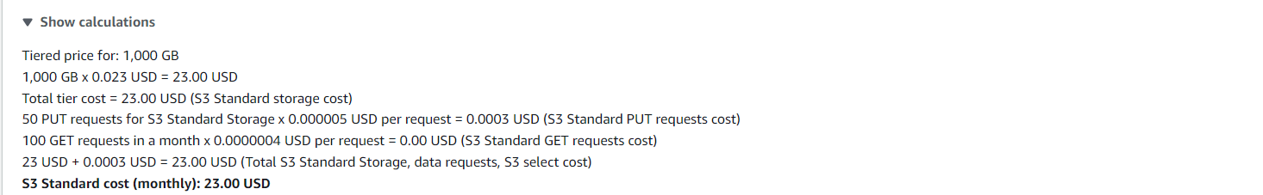
EC2
S3

Slide 7
1.Sign-in to AWS Root Account
1.Search for AWS Management Console.
2.Open to the AWS Management Console.
3.Click on “Sign In to the Console”.
4.Choose “Root user” as the login method.
5.Enter Email and Password that is associated with your AWS root account.
6.Click on Sign in.

Slide 8
2.SETTING UP IAM
1.Open AWS dashboard in AWS Management Console.
2.Search for IAM in Search bar and open IAM dashboard.
3.Go to Users and create the number of users based on your requirement ,we don’t have the requirement to create a Group as of now, because we are creating a single IAM user.
4.Configure the name of the user , and Click on Checkmark - Custom password and Click on Checkmark User must create a new password at next sign-in.
5.Now Select - Attach Policies Directly in Permission Options and Search the required permissions for the IAM user account that we are creating.
6.Now we are Selecting required permissions to our IAM user based on our project requirements in Permissions Policies.
7.Iam FullAccess,AmazonEC2FullAccess,AmazonVPCFullAccess,AmazonS3FullAccess.
8.After selecting the permissions click on Create user.

Slide 9
3.SETTING UP VPC
1.Open AWS dashboard in AWS Management Console.
2.Search for VPC in Search bar and open VPC dashboard.
3.Click on create VPC ,Now select VPC only in VPC Settings and give a name to your VPC.
4.Select IPV4 CIDR – (10.0.0.0/26 , the block size is 64 Class C), and click on Create VPC.
5.In VPC dashboard now click on Subnets(We require 2 subnets based on requirement).
6.Select the created VPC in VPC ID , while creating subnet - Subnet 1 was created with subnet name as publicsubnet , under the region us-east-1a, IPv4 VPC CIDR Block :10.0.0.0/24, IPv4 Subnet CIDR Block 10.0.0.32/27 .
7.Subnet 2 was created with subnet name as privatesubnet , under the region us-east-1b , IPv4 VPC CIDR Block :10.0.0.0/24, IPv4 Subnet CIDR Block 10.0.0.64/27 .
8.Two Subnets are successfully created in your VPC.

Slide 10
4.Setting Up Internet Gateway
1.In VPC dashboard ,Select Internet Gateway.
2.Create an Internet Gateway, give a name in name tag in internet gateway setting.
3.Create the Internet Gateway.
3.Click on the pop up or click on actions in top right corner to Attach to a VPC.
4.Select already created VPC in Available VPC’s and click on Attach Internet Gateway.
5.Internet Gateway is successfully attached to the existing or created VPC.

Slide 11
5.Setup Default Route table of VPC
1.While creating VPC , a default RouteTable is created, Each subnet in your VPC is associated with a route table which controls the traffic flow between subnets.
2.Give a name as webroute1 to the default created Routetable.
3.Select the default Route table - webroute1
4.Click on Routes ,Click on edit route and add route – Choose 0.0.0.0 in left dropdown & Choose Internet Gateway in Right dropdown and exactly down to it select created Internet Gateway.
5.Click on Save changes.
6.Click on Subnet Associations , Click on edit Subnet Associations & select the public subnet created under VPC and Click on save changes.
7.Now we successfully updated the Routes and Subnet Associations of Default Route Table

Slide 12
6.Setting up NAT Gateway
1.Open NAT Gateways in VPC Dashboard.
2.Click on Create an NAT Gateway , give name to the NAT Gateway as webnatgw
3.Select publicsubnet, & Click on Allocate Elastic IP in Elastic IP allocation ID.
4.Click on Create NAT Gateway.
5.Open Route table in VPC Dashboard, Create a new route table with name as webroute2.
6.Select the created VPC & Create Route Table.
7.Select the newly created Route Table , Click on Routes.
8.Click on edit route and add route – Choose 0.0.0.0 in left dropdown & Choose NAT Gateway in Right dropdown and exactly down to it select created NAT Gateway.
9.Click on Save changes.
10.Click on Subnet Associations , Click on edit Subnet Associations & select the privatesubnet created under VPC and Click on save changes.
11.Now we successfully updated the Routes and Subnet Associations of Default Route Table

Slide 13
7.Launch Template
1.Search for EC2 in the AWS Management Console & open EC2 Dashboard
2.Click on Launch Template , give a name to template as webtemp and version description as websitetemplate.
3.Click on Quick start & Select an AMI(Amazon Machine Image) based on requirement of the task , Our requirement is Microsoft Windows Server 2022 Base.
4.Choose the type of instance in Instance Type based on requirement Our requirement is t2.micro
5.Select an existing key pair or create a new Key pair : Vockey (Already created Key-pair)
6.Choose the VPC and subnet, where you want your instances to be launched in Network settings.
7.Select created VPC (webvpc) & select the publicsubnet in Subnet.
8. Review your settings and click on Create launch template.

Slide 14
8.Setting Up Load Balancer
1.In the EC2 Dashboard, Click on Load Balancing in the left sidebar.
2.Click on Create Load Balancer & Choose the type of load balancer Based on requirement,
Our Requirement is : Network Load Balancer (NLB) for high performance and low latency.
3.Give a name for your load balancer as “webloadbalancer” & Select the VPC (webvpc) ,Checkmark the availability zones for which your are creating Load Balancer.
4.In Listeners and routings , Choose TCP & Select existing Target Groups or Create a new Target Groups, We are creating a new target group so Click on Create new Target Group.
5.Choose target type - select Instances in Basic Configuration, Give Name to Target Group , Choose Protocol : Port -TCP : 80 as per our requirement & Choose the VPC (webvpc)
6.Health Checks: Choose TCP in Health Check Protocol, Click on Next & Create Target Group.
7.In Listeners and routing Select the created Target Group, click on next .
8.Review all Settings and Click Create Load Balancer.

Slide 15
9.Setting Up Auto Scaling Groups
1.Click on Create Auto Scaling Group, Give name to the Auto Scaling Groups ,Choose the version of the Template
2.Choose VPC & Availability Zone and Subnets in Network.
3.Select Attach to existing Load Balancer in Load Balancer type & select the existing Target Group.
4.Select the following options in 9.5.
5.Set the Health Check Grace Period in Health Checks as 120 seconds
6.Enter Desired Capacity (Number of Instance required in VPC) in Group Size.
7.Minimum Capacity (Set the minimum number of instances -1)
& Maximum Capacity (Set the maximum number of instances - 10).
8. Select the Following Options in 9.8 & Create Auto Scaling Group
9.Requried Instances are created based on template settings.

Slide 16
10.Setting up S3 bucket
1.Open AWS dashboard in AWS Management Console.
2.Search for S3 in Search bar and open S3 dashboard, Click on Create Bucket.
3.Select the bucket type as General Purpose, Give Unique bucket name to your bucket.
4.Checkmark on Block All public Access, Select ACL’s disable in Object Ownership & Create on Bucket
5. Select the S3 Bucket ,Click on Objects ,Click on Upload & Choose the file in your PC
6.Click on file to be uploaded and Click on Upload.
7.When we use the Object URL of this file in S3 bucket it will be only available for your Private users
8.If the Public Users wants to access the website
9.Select the file in S3 bucket ,Click on permissions, Uncheck mark the “Block all public access” to convert into Public ,Copy the Bucket ARN number & Click on Edit on Bucket Policy

Slide 17
10.Select S3 bucket policy in Select Policy type ,Click on Allow Effects & Type * in Principles
11.Check mark All Actions , Paste the Bucket ARN and enter /* after Bucket ARN
12.Click On Add Statement & Click on Generate Policy
13.Copy the code from AWS Policy and Paste it in Bucket Policy & Save it
14.Bucket Policy edited Successfully
15. Now public users can access our website by Object URL

Slide 18
Conclusion
In this project , we successfully developed and hosted a website using HTML, CSS, and JavaScript, making it accessible to our customer globally by uploading the files in an S3 bucket.
To ensure that the website remains available at all times and can handle various traffic loads, we implemented Auto Scaling Groups, which adjusts the number of servers (Min : 2 & Max : 4) based on traffic.
We also included a load balancer to handle potential failures and distribute traffic efficiently, ensuring that the website stays operational even if some components fail.
We used IAM to set up secure access controls for AWS resources and configured a VPC to manage network traffic effectively.
Overall, these measures collectively provide a robust, high-availability, and fault-tolerant solution for our website hosting needs.

